Slide 1
Butner Public Safety
Police and Fire Department
March 11, 2024

Slide 2
Butner Public Safety

Slide 3
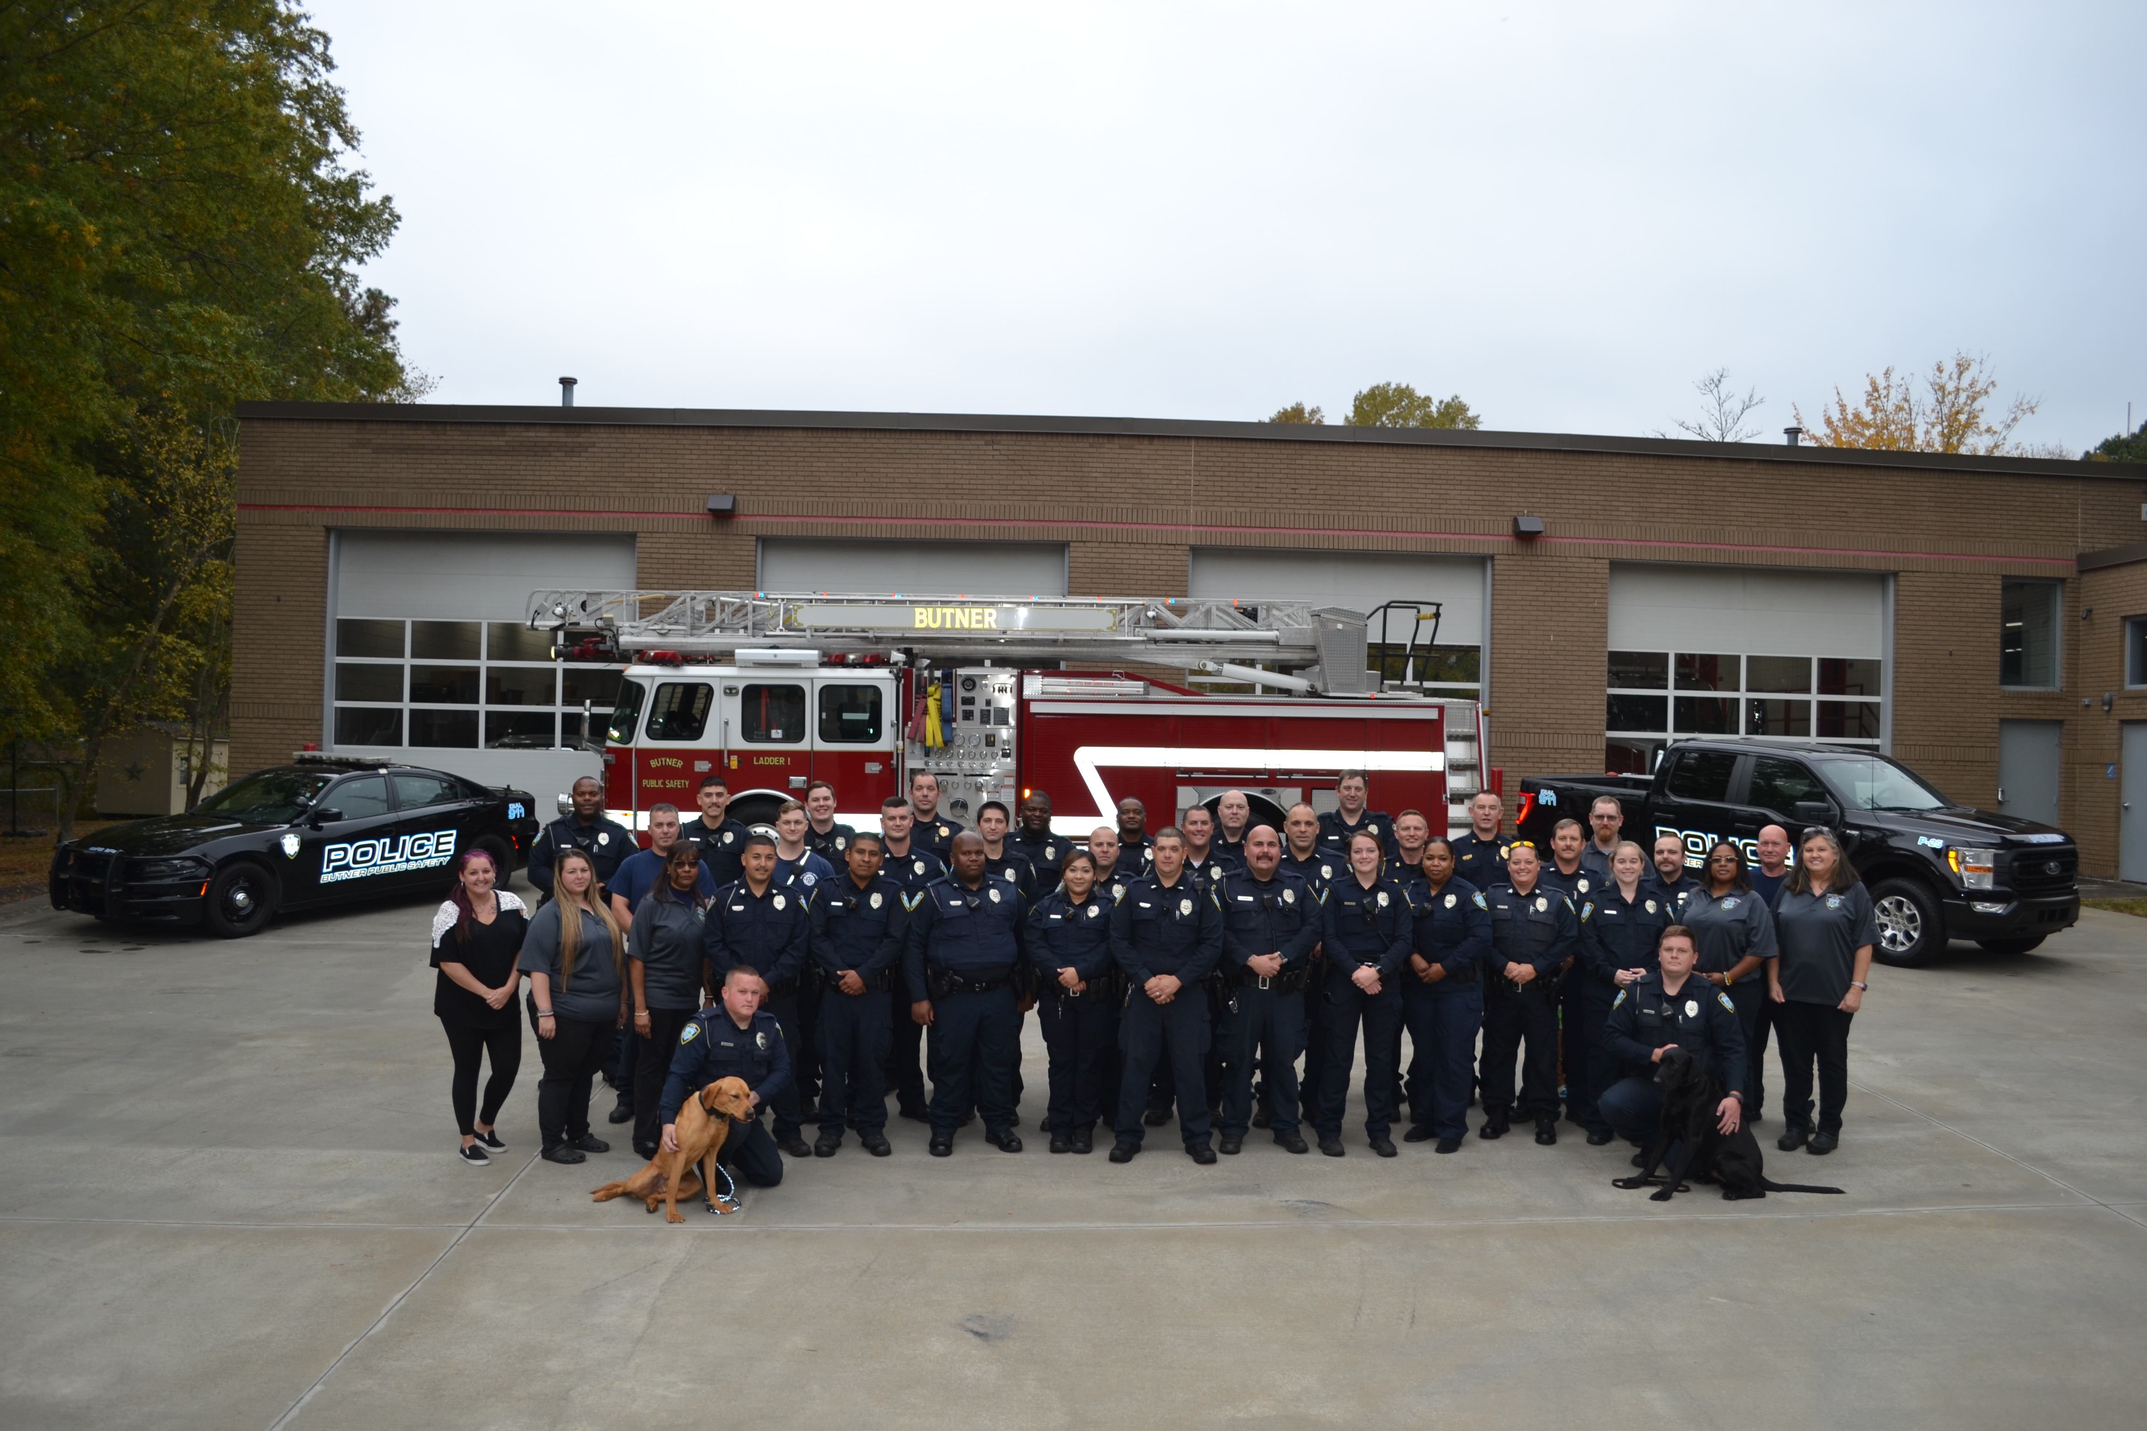

Slide 4
The Mission of Butner Public Safety
To provide the people, businesses and institutions of its jurisdiction with professional fire and law enforcement services, thereby enhancing the quality of life of those served by Butner Public Safety.

Slide 5
History
Butner began as a military training camp in 1942 after the beginning of World War II
Camp Butner closed in 1947 and was taken over by the State of North Carolina. Butner Public Safety was created as a state organization to provide fire and police protection to the state owned facilities and the town until 2007.
From 2007 to 2013 Butner Public Safety was overseen by an authority until the Town of Butner acquired the department in 2013.
Butner Public Safety is now overseen by the Town of Butner and is a local government agency.

Slide 6
Overview of How Public Safety Works in Butner
Butner Public Safety is a true public safety department. All officers perform dual roles as law enforcement officers and firefighters. We are law enforcement and firefighters at all times. Four platoons of six officers are assigned to primary police and fire response. Officers are assigned to police or fire duties daily based on qualifications. Those officers assigned to patrol perform law enforcement duties until a fire related call is dispatched then the officers switch to the role of firefighter. Once the fire incident is completed, those officers switch back to their patrol duties.

Slide 7
Department Organization
Butner Public Safety is managed by a Director who oversees both police and fire services. There are 33 sworn officers, 4 fire engineers, 4 Telecommunicators, Volunteer Firefighters and 2 non-sworn employees in the department.
The Police Captain and Fire Captain oversee the daily operations of the department.
The Police Captain manages 4 patrol platoons, which includes two K-9 officers, and our Special Operations division. Special Operations includes Investigations, School Resource Officer and Central Regional Hospital contracts.
The Fire Captain manages a Support Services Sergeant, Records and Technology Admin, and Volunteer Firefighters.

Slide 8
Department Organization
There are 3 division within Butner Public Safety:
Administration Division-Director, Police Captain, Fire Captain, Support Services Sergeant, Administrative Specialist, Records and Technology Admin
Patrol Division-4 Lieutenants, 4 Sergeants, 10 officers, 2 K-9 officers, 4 fire engineers, and 4 Telecommunicators
Special Operations Division-1 Central Regional Hospital Sergeant, 2 SRO, and CIU-1 Lieutenant, 1 Sergeant, 1 Officer

Slide 9
Patrol Shift Schedule
The Patrol Units follow the DuPont Schedule.
The DuPont Schedule is a 28-day cycle consisting of 12 hours shifts . BPS patrol shifts are from 0600-1800 hrs. and 1800-0600 hours.
A typical cycle starts on Friday night, Saturday night, Sunday night, and Monday night. The employee is then off 3 days. The next cycle begins Friday day, Saturday day, and Sunday day. The employee is off 1 day. Cycle begins Tuesday night, Wednesday night, and Thursday night. The employee is off 3 days. The last cycle begins Monday day, Tuesday day, Wednesday day, and Thursday day. The employee is then off Friday-Thursday and schedule starts over again.

Slide 10
What will my salary be?
Level of Experience | Hiring Rate | Rate at 6 months
No experience | $46,886 | $49,230
Fire certification only | $49,230 | $51,692
Police certification only | $51,692 | $54,277
Certified in Police and Fire | $59,841 | $62,833
Note: On average, employees receive a 3% cost of living (COLA) increase and 2.5% merit increase each year.

Slide 11
What are the benefits?
Insurance benefits are effective the first day of the month after you are hired and are free for employee only coverage.
Medical Insurance
Short-term Disability
Dental Insurance
Pension Plan with Local Government Employees Retirement System (LGERS) 6% of pay
Department paid dues to the North Carolina Firefighter’s Pension Fund
Town contribution of 5% to the North Carolina 401k Supplemental Retirement Plan

Slide 12
What are the benefits?
On-site gym
Vision Benefit Plan
Paid vacation and sick leave
Employee Assistance Program
Employee Tuition Assistance of $2,000 each year
Longevity payments start after 2 years
2.5% raise for Senior Public Safety Officer
2.5% raise for Master Public Safety Officer
2.5% increase for bilingual Spanish-English certification
Assigned Vehicle after certifying as LEO and FFII

