Slide 1
Planning Department Report
January 4, 2024

Slide 2
December Activity
Met to discuss the Performance Stage at Gazebo Park
Met with DFI at UNC for updates to the Gateway Area study
Attended a Camp Butner partners meeting
Continued work on the Meritage/Lyon Station project
Board of Adjustment / Planning Board
Both meetings are cancelled in January due to lack of applications
Code Enforcement
Three (3) open violations

Slide 3
2023 Year End
81 zoning permits were issued
6 new business permits were issued
Business Name | Type of Business | Address
Shreve Alcohol Company | Distillery | 22 E A Street
Fabian New & Used Tires Automotive | Automotive Repair | 109 Central Avenue
HaztuLoko Evelyn’s | Ice Cream and Smoothie Shop | 322 Central Avenue
Guacamole Tacos & Tequila | Restaurant | 102 W B Street
Guardian Angel Healthcare LLC | Adult Daycare | 1555 NC Highway 56
JLG Equipment Services | Outdoor Storage | 800 Business Park Drive

Slide 4
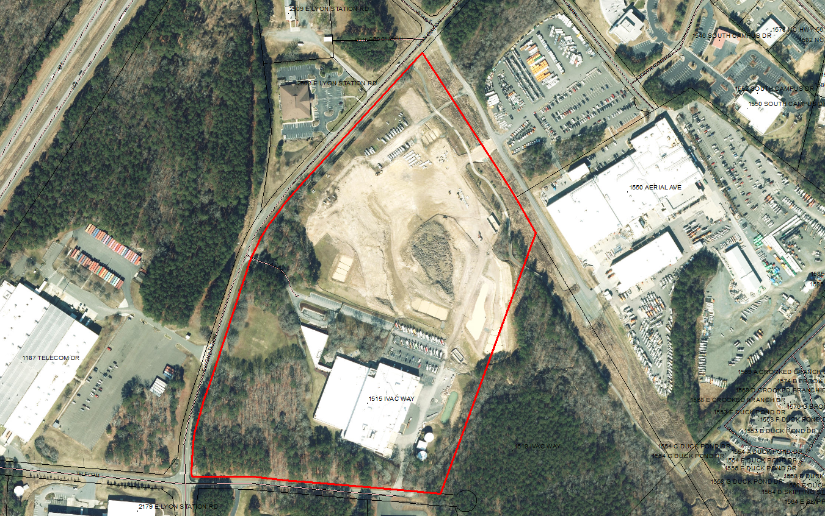
Cookout
Altec Gen II Expansion
Expansion of existing office building and parking lot
Stormwater deposit paid
First set of plans reviewed
Received a variance from Article 9.6 (landscaping)
2538 E Lyon Station Road
Demolishing old bank building to construct drive thru restaurant
Stormwater deposit paid
First set of plans reviewed

Slide 5
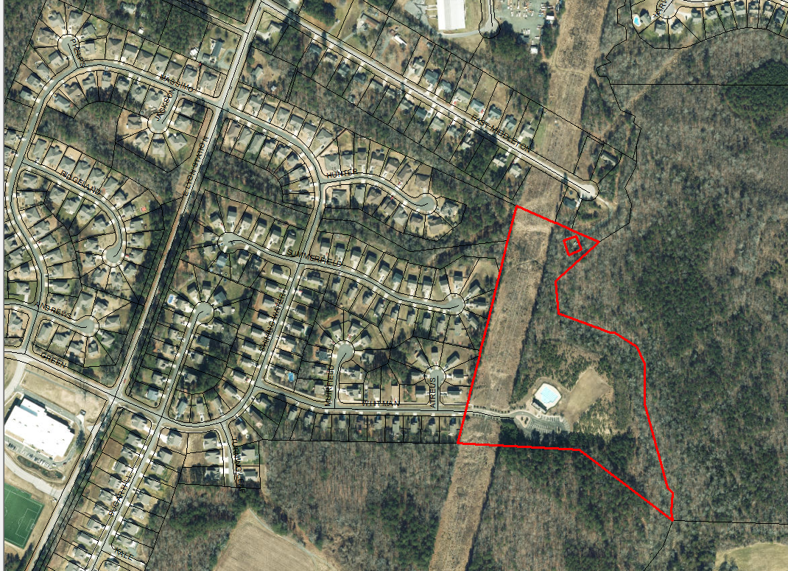
SGWASA Village Court Lift Station
New lift station proposed off Village Court near Tractor Supply
Stormwater deposit paid
First set of plans submitted and reviewed
SGWASA E. Middleton Drive Lift Station
New Lift Station proposed off East Middleton Drive near Flemming Farm
Stormwater deposit paid
First set of plans submitted and reviewed

Slide 6
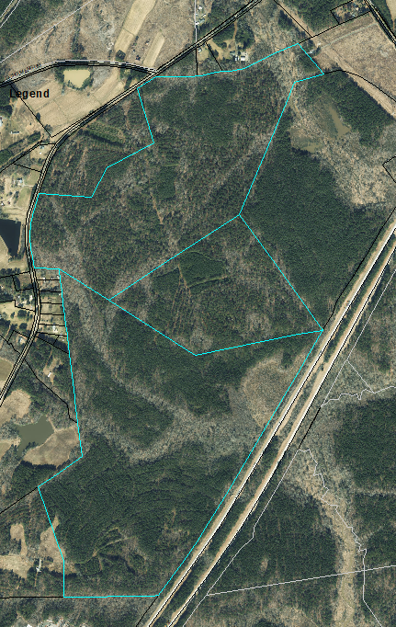
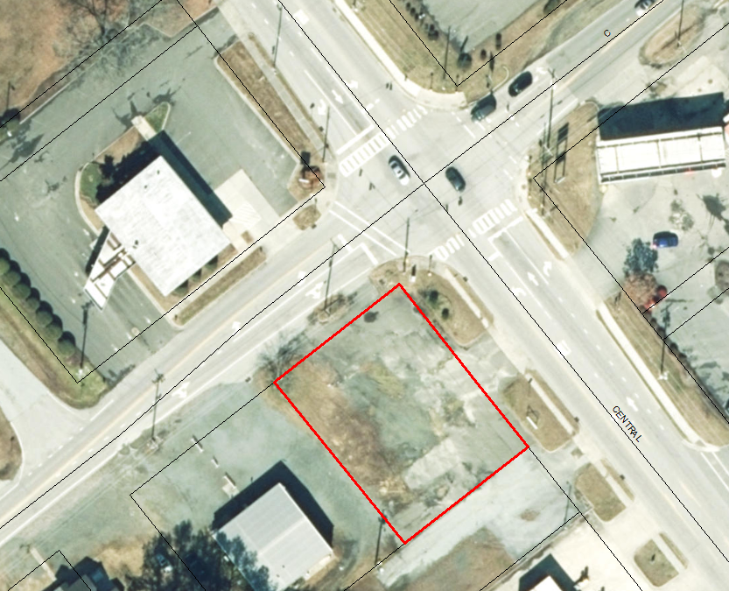
Meritage Homes
800+ lots proposed along W Lyon Station Road
Planned Unit Development (PUD) Rezoning
Planning Board recommended approval at their December 14, 2023 meeting
American Hero
Redesigned plans from their 2018 approvals in CX zoning district
Concept plan will need to appear before Planning Board and Town Council for review and consideration

Slide 7
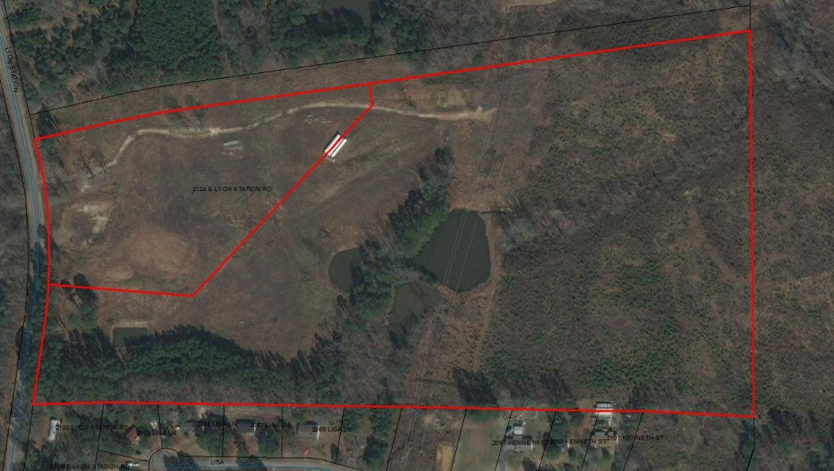
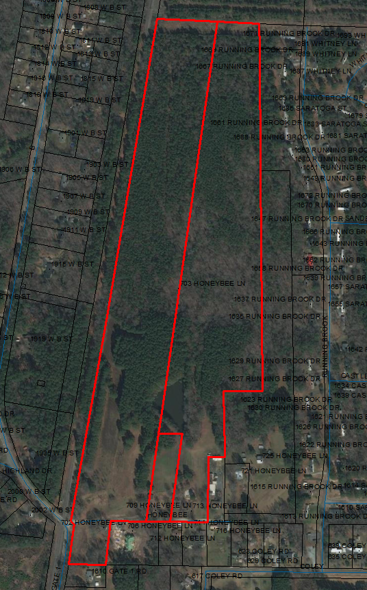
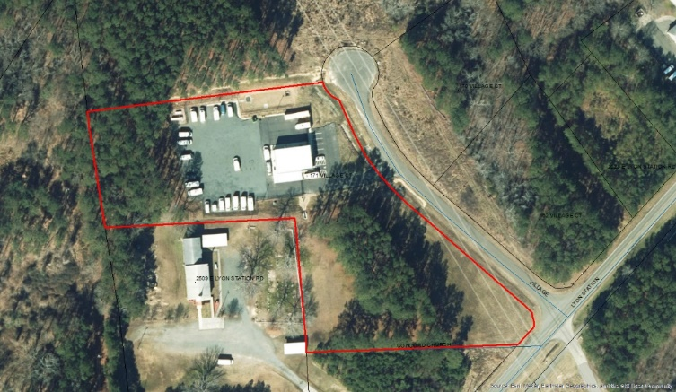
Ongoing Projects
Creedmoor Fuel – awaiting DOT approval
Tarpey Solar Farm – final CO issued
Stream RV – Under Construction

