Slide 1
Planning Report
Long-Range and Current Planning, Environment and Stormwater, Transportation, Economic Development, Land Use, Parks and Open Space, Code Enforcement…
June 1, 2023

Slide 2
Planning Staff: Planning: Environment, Economic Development, Land Use, Transportation…
PARTF grant pre-approval inspection held on Tuesday, May 30
Staff attended UNRBA meeting on May 17
Granville County Parks and Recreation Mini-grant has been recommended approval in the amount of $15,000 to fund one canopy shade structure for BAP Commissioner meeting will be held later this month for final approval
Staff held predevelopment meeting with SGWASA to discuss review process for pipeline and lift station improvements.
Board of Adjustment / Planning Board
Due to lack of agenda items, there will not be a Planning Board meeting in July
Board of Adjustment scheduled for Quasi-Judicial virtual training through the School of Government 6.8.2023
MS4 and Stormwater
Annual inspections began and are due by June 30. There are 22 SCMs in the Town that require annual inspections
Code Enforcement
There are currently open violations within the Town of Butner, 2 were resolved this month
Gravel lot constructed without permits located at 2054 E Lyon Station Road has been approved to remove gravel lot, and to replant vegetation to bring property into compliance. Stormwater review completed by stimmel stated that a stormwater permit was not required for this project. An inspection will occur after work has been completed..
109 Central Avenue has been approved for a permit to continue a nonconforming automotive repair use. Owner provided evidence that this use had been in place less than 6 months prior to new application.
Development Project Updates
The following pages include ongoing projects that have not received final zoning inspection

Slide 3
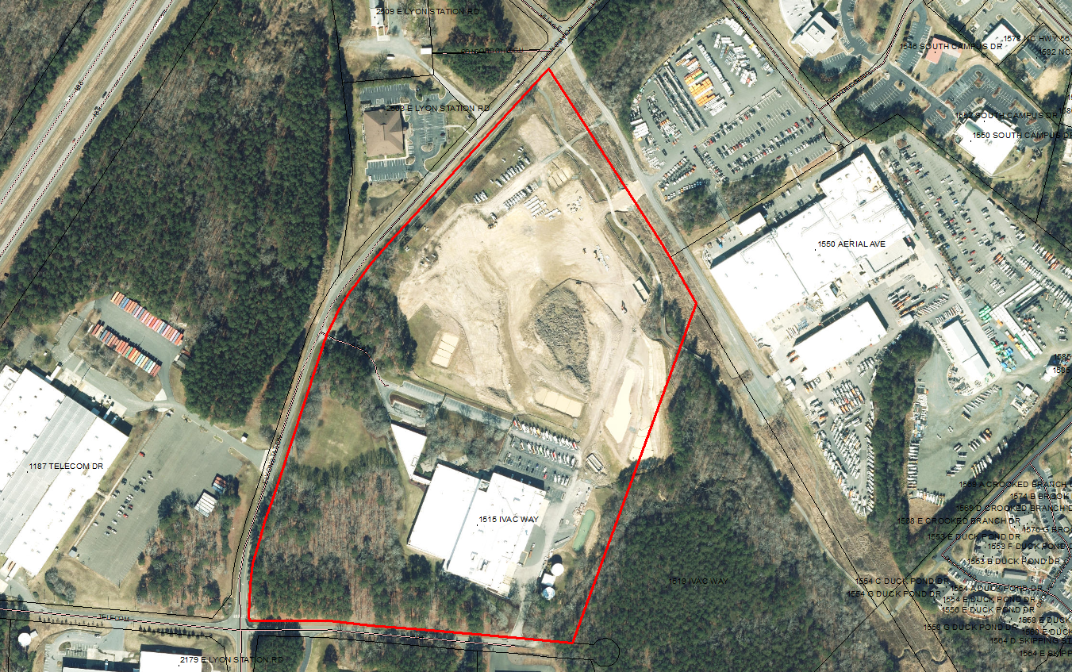
Stream RV
Altec Gen II Expansion
Expansion of existing office building and parking lot
Stormwater deposit paid
First set of plans reviewed and comments submitted
Expansion of existing Stream RV business at 171 Village Ct
Staff reviewed and held meeting with engineer to resolve issues present in plans.
New plans expected to be submitted for review.

Slide 4
Creedmoor Fuel
Project that began in 2017 and expired.
Awaiting Revisions to plans
Others
Jarco Supply
Final Permits Issued
Construction underway
Final Zoning Inspection will take place prior to C/O
Meritage Homes / Lyons Station Planned Unit Development
Project on hold until further notice.
Tarpey Solar Farm
Construction underway
Final Zoning Inspection will take place prior to C/O

