Slide 1
Planning Report
Long-Range and Current Planning, Environment and Stormwater, Transportation, Economic Development, Land Use, Parks and Open Space, Code Enforcement…
July 6, 2023

Slide 2
Planning Staff: Planning: Environment, Economic Development, Land Use, Transportation…
Staff met to discuss THRIVE grant which had been denied. We were highly recommended but there was substantial competition for this grant this year. Staff is looking into other grant opportunities.
Staff attended DCHC MPO meeting on June 27
Staff attended Ker Tarr COG meeting on June 22
Granville County Parks and Recreation Mini-grant has been recommended approval in the amount of $15,000 to fund one canopy shade structure will be presented at July Granville County Board of Commissioners meeting
Staff held predevelopment meeting with SGWASA to discuss review process for pipeline and lift station improvements.
Board of Adjustment / Planning Board
There will be a planning board meeting in August to consider updates to permit food trucks with restrictions throughout Town, lessening restrictions on minimum lot dimensions in CB zoning district, and update Article 15 (see below) to comply with DWR standards
Board of Adjustment completed Quasi-Judicial virtual training through the School of Government 6.8.2023
MS4 and Stormwater
SWMP updated and submitted to DWQ
Staff attended DWQ MS4 Update Webinar held June 25, 2023
Staff working to update Article 15 of Butner LDO to comply with new Watershed Model Ordinance from DWQ
Code Enforcement
There are currently 8 open violations within the Town of Butner, 4 were resolved this month
Staff met with engineer regarding bringing St. Bernadette Church into compliance. He has been working diligently on plans and staff expects to see site plan and stormwater submittal within the next few months. Building has been placed over property line and staff may not sign off on recombination until it has been moved and survey reflects this change.
Development Project Updates
The following pages include ongoing projects that have not received final zoning inspection

Slide 3
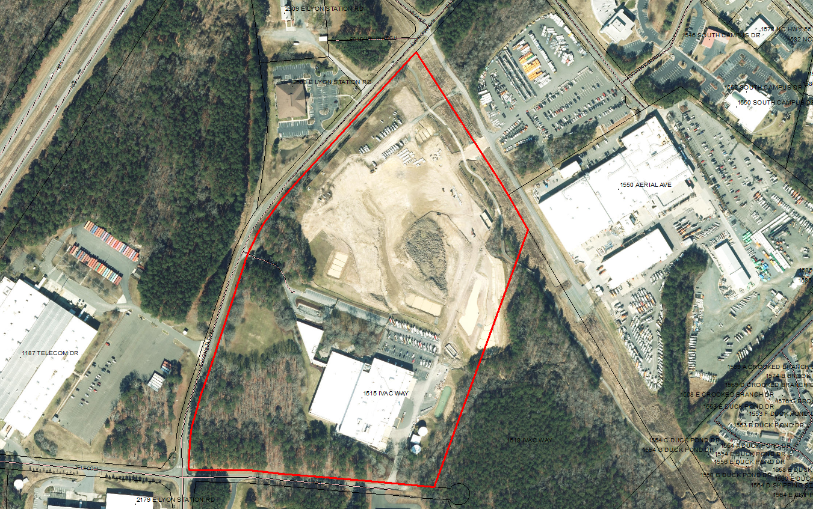
Stream RV
Altec Gen II Expansion
Expansion of existing office building and parking lot
Stormwater deposit paid
First set of plans reviewed and comments submitted
Expansion of existing Stream RV business at 171 Village Ct
Second set of plans submitted and reviewed. Awaiting approval from various entities prior to permit submittal.

Slide 4
Tarpey Solar Farm
SUP 18-01
Developer requested time to plant buffer at more appropriate growing season.
Temporary C/O issued and will expire 12.13.2023
Final buffer must be planted and inspected prior to final C/O
Jarco Supply
Final Zoning Inspection will take place prior to C/O
Altec Chasis Storage Lot Ph II and III
Reviewed and approved for C/O
Creedmoor Fuel
Met with Engineer and expect revised plans to be submitted within one month
Meritage Homes
Meeting held with developer 6.29
Other Projects

