Slide 1
Planning Report
Long-Range and Current Planning, Environment and Stormwater, Transportation, Economic Development, Land Use, Parks and Open Space, Code Enforcement…
SEPTEMBER 7, 2023

Slide 2
Planning Staff: Planning: Environment, Economic Development, Land Use, Transportation…
Staff met with DFI to discuss study
Staff met with DOT regarding Meritage project, a meeting between Meritage and DOT, and Meritage and SGWASA is next step to keep project moving forward
Staff purchased a new ESRI license for GIS software so multiple staff members may have access to it at any given time
Staff met with Stormwater Utilities Group – a new study will be conducted for stormwater utility fee.
Staff met with UNRBA to discuss Consensus Principles and potential future changes proposed to Falls Lake Rules. These Consensus Principles will be brought to Council during the October 5 meeting. These principles will need to be recommended by every jurisdiction within the Falls Lake Watershed by November 8 for the project to continue moving forward.
Staff attended NCAZO conference in Charlotte NC to maintain licensure, legislative update by the School of Government was reported at conference.
Staff attended KTRPO meeting on August 24. Regarding Veazy Road project – DOT is reviewing information from Federal Government which impacted funding for many projects before they discuss awards with jurisdictions. It is still anticipated that we will be awarded those funds.
Board of Adjustment / Planning Board
There will be a planning board meeting in September to consider updates to permit food trucks with restrictions throughout Town and update Article 15 (see below) to comply with DWR standards. These items were tabled at the last meeting
Code Enforcement
There are currently 12 open violations within the Town of Butner, None were resolved this month
Reminder letters for SCM Maintenance Inspections were sent to property owners
Development Project Updates
The following pages include ongoing projects that have not received final zoning inspection

Slide 3
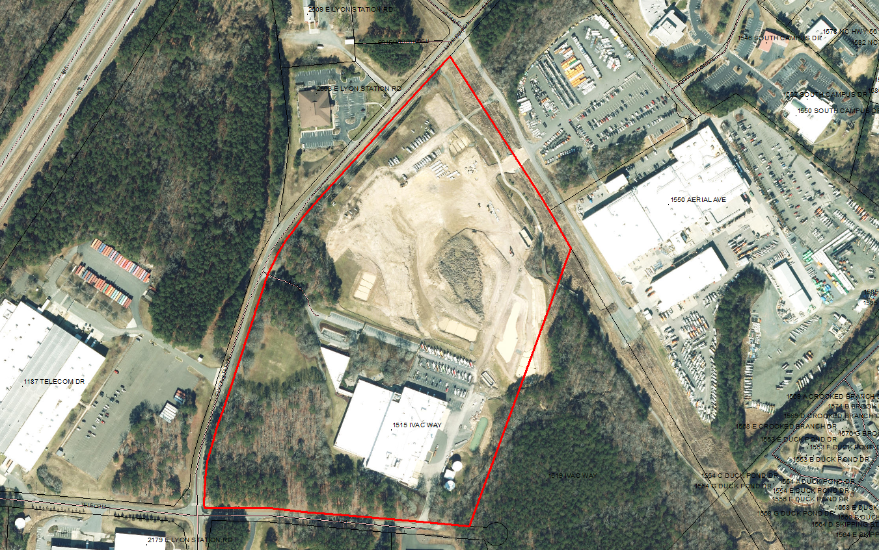
Stream RV
Altec Gen II Expansion
Expansion of existing office building and parking lot
Stormwater deposit paid
First set of plans reviewed and comments submitted
Expansion of existing Stream RV business at 171 Village Ct
Starting to get approval from various entities. Permit anticipated to be issued in the near future.

Slide 4
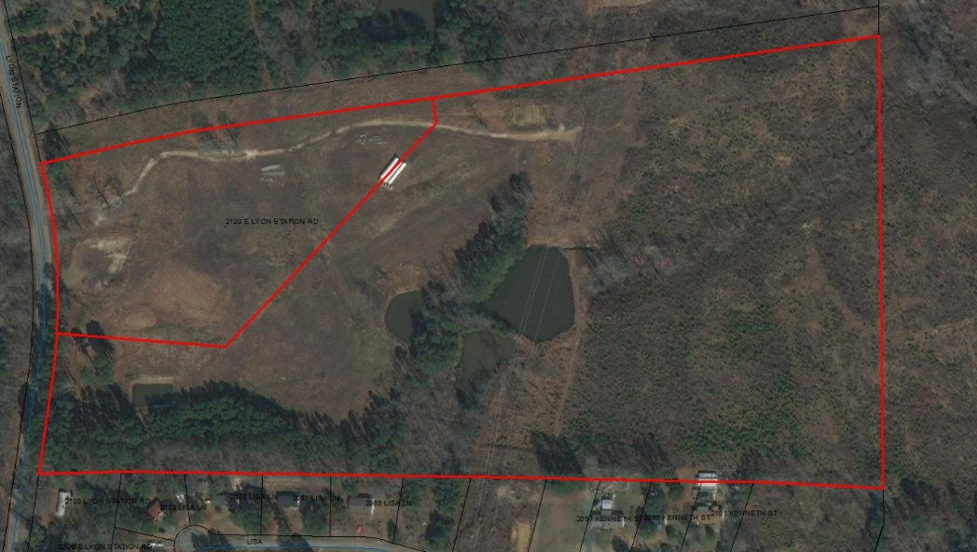
Tarpey Solar Farm
SUP 18-01
Temporary C/O issued and will expire 12.13.2023
Final buffer must be planted and inspected prior to final C/O
Developer scheduled to install buffer in October
Creedmoor Fuel
Revised set of plans submitted after long wait
Comments submitted
Receiving various approvals from required entities, still working to resolve a handful of comments as well as stormwater approval prior to permit issuance

